Slide 1
Population and Economic Growth
Ali Afzal

Slide 2
Six Basic elements of Research design
Purpose of the study : Descriptive (Correlational) Study
The extent of researcher interference : No Interference
The study setting : Non contrived
Research Strategies : Observations
Unit of Analysis : developing countries
The time horizon of study : Longitudinal

Slide 3
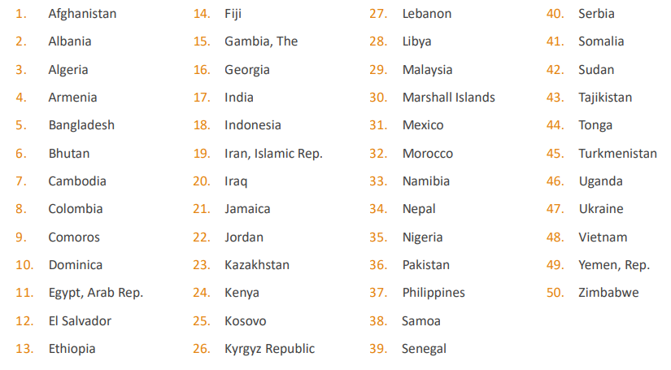
List of developing countries

